Slide 1
Statistics for Reporters
Sean McMinn

Slide 2
Steps to a data story
Find data
Clean data
Analyze data
Present data

Slide 3
Agenda
Examples
Statistical concepts you should know

Slide 4
Statistics for reporters
Summarize information
Mean, median, mode
Make comparisons/correlations
Averages/trends between groups
Make “predictions”
Use past data to predict future or missing data
**this is risky**

Slide 5
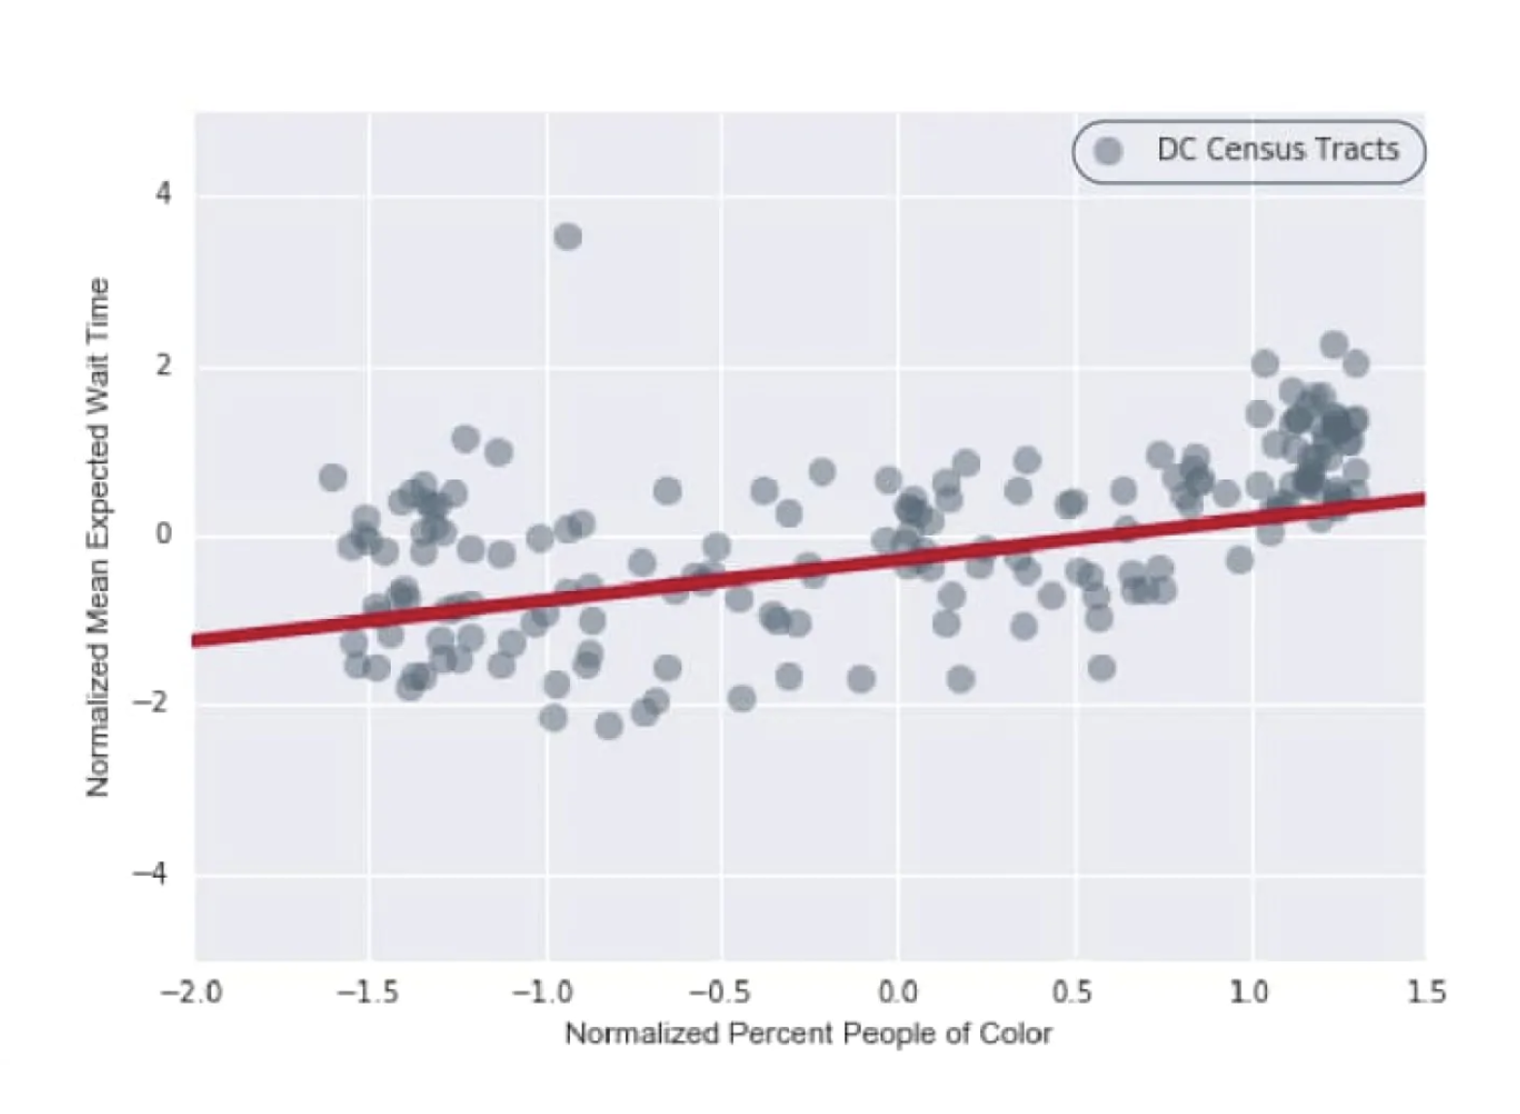
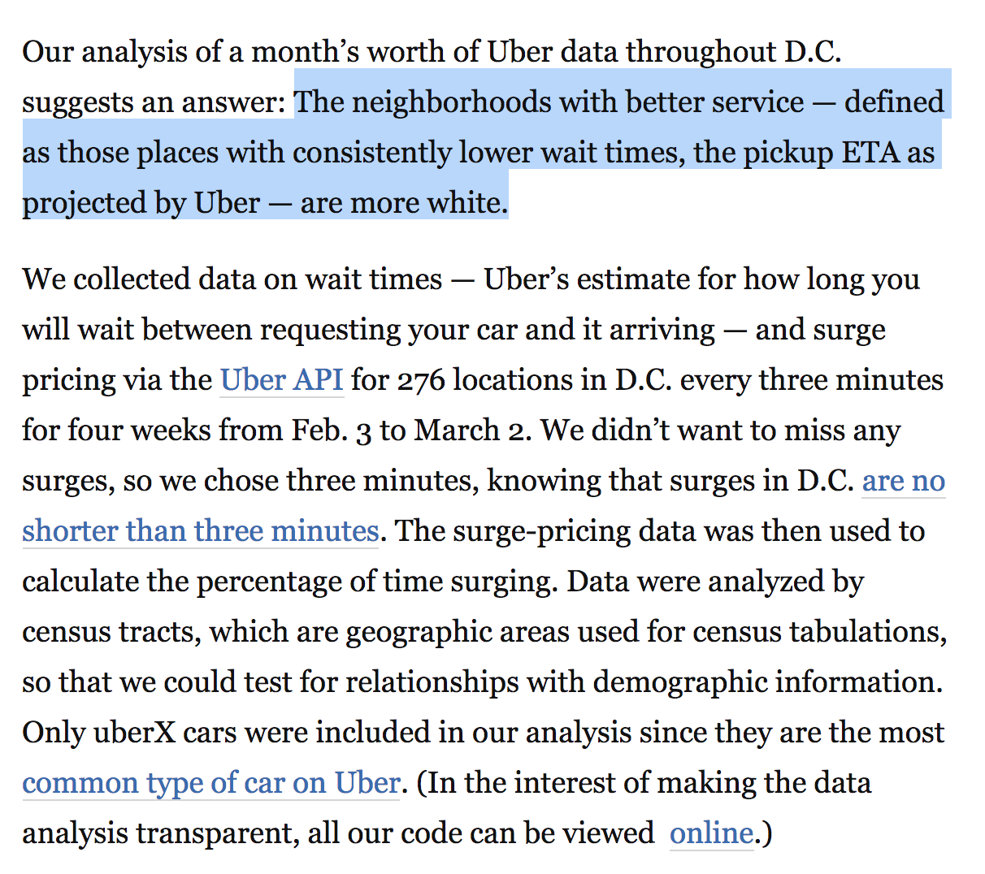
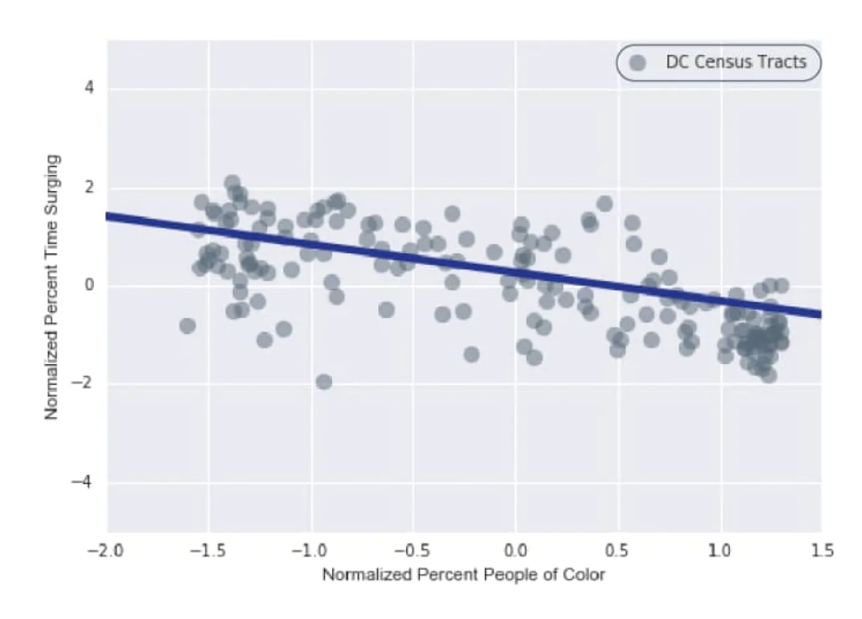
Stories with statistics
https://www.washingtonpost.com/news/wonk/wp/2016/03/10/uber-seems-to-offer-better-service-in-areas-with-more-white-people-that-raises-some-tough-questions/

Slide 6
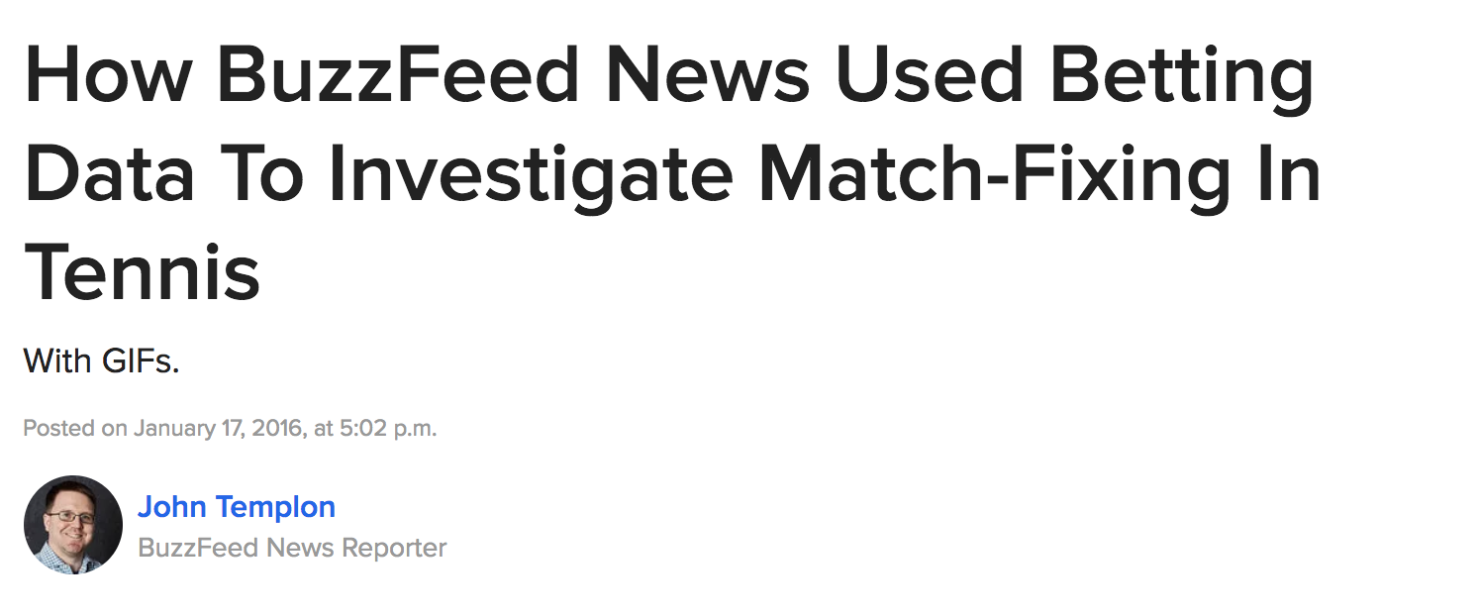

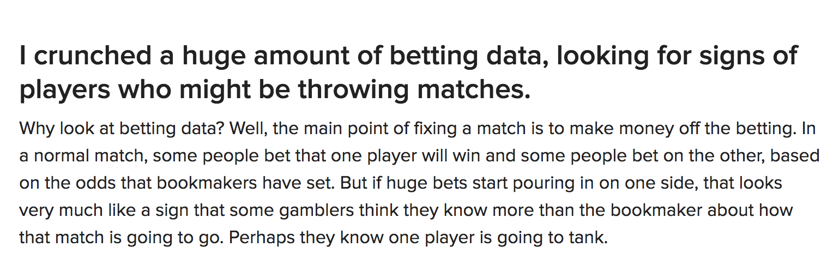
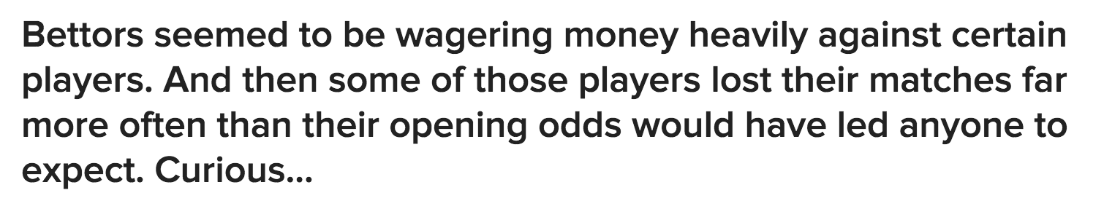
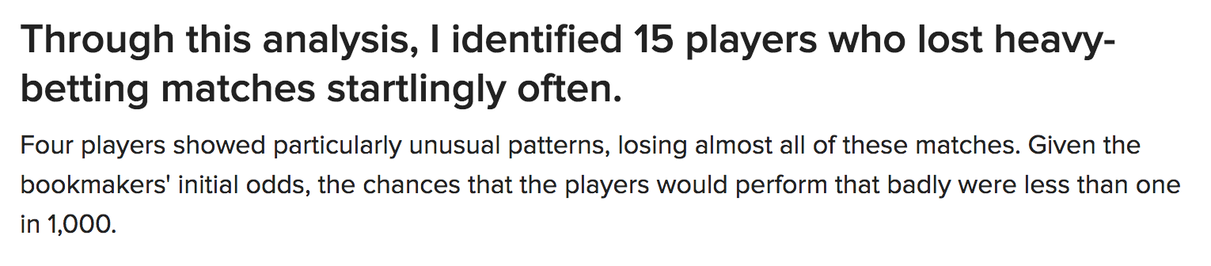
Stories with statistics
https://www.buzzfeednews.com/article/johntemplon/how-we-used-data-to-investigate-match-fixing-in-tennis

Slide 7
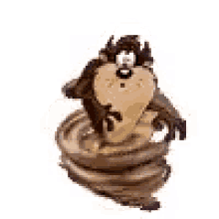
Whirlwind of statistics
For reporters!

Slide 8
Descriptive statistics
1+2+6+7+9+12+14
Mean
Average
Median
= 7.29
7
1,2,6,7,9,12,14

Slide 9
Descriptive statistics
When to use each?

Slide 10
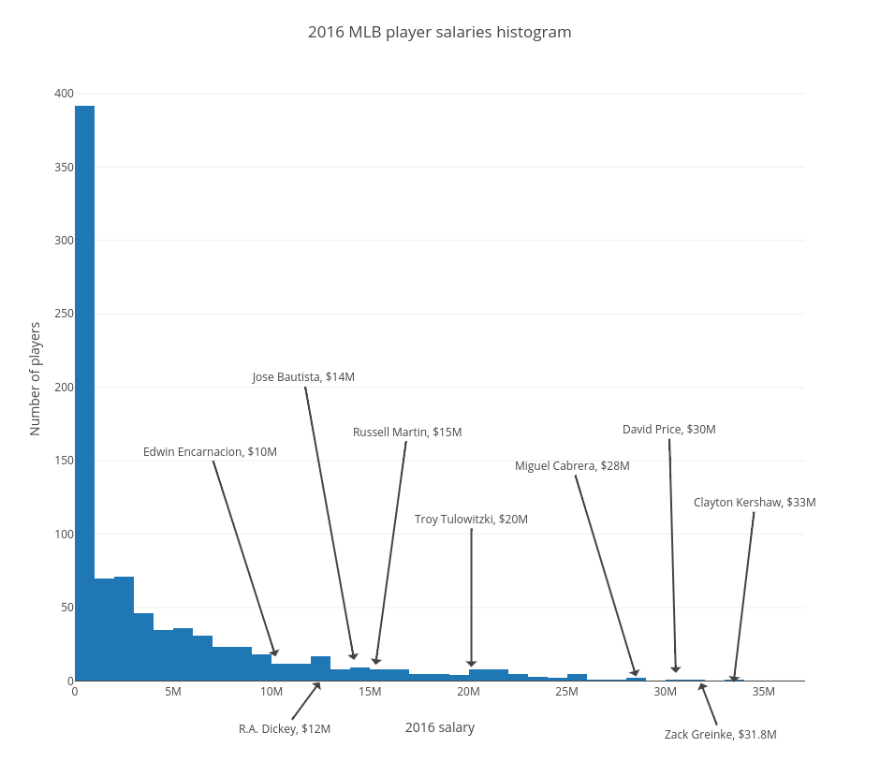
Descriptive statistics
Mean is generally a good bet
Unless …

Slide 11
Descriptive statistics
If data is skewed, mean is not robust to outliers, and will be heavily influenced by them
Instead, use median — which *is* robust to outliers
~median
~average

Slide 12
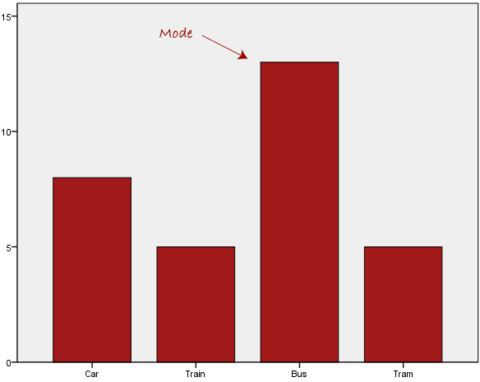
Descriptive statistics
Other descriptive statistics
Mode: most common value
Be careful: mode does not equal “most” or “majority” – more often means “plurality”

Slide 13
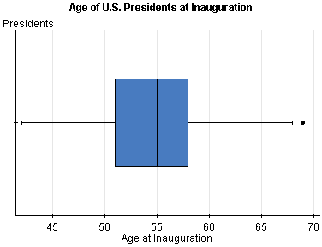
Descriptive statistics
Other descriptive statistics
Quantiles: Range of first quarter of data, second quarter of data, etc…
End of second quantile is also median!

Slide 14
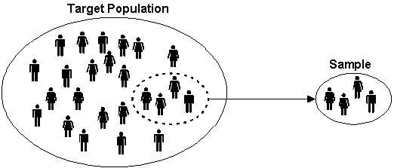
Regression/inference
Can’t survey/sample everybody
This is what polling is all about
Use sample mean to infer population mean

Slide 15
Drawing Conclusions
You are a severe migraine patient in an NIH study. Every day, you record whether your symptoms are better or worse than an “average” day.
You do this for 25 days.

Slide 16
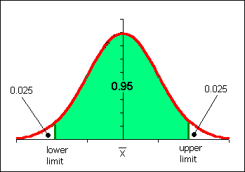
Activity
When we look at all the patients, we should see something like this: a normal distribution.

Slide 17
Activity
When we look at all the patients, we should see something like this: a normal distribution.
15
16
14
14
16
15
13
11
12
12
12
4
15
10
7
17
15
11
14
15
12.5 better days
12
9
16
9
16
14
13
15
6
14
16
12
11
13
17
15
12
11
10
12

Slide 18
Activity
What if we do this with patients getting the drug, and they have an average of 17 better days?
Does this mean the drug worked?

Slide 19
Activity
What if we do this with patients getting the drug, and they have an average of 17 better days?
12.5 better days
17 better days

Slide 20
Activity
p value = .095594
12.5 better days
17 better days
.095594

Slide 21
Activity
Sam thing – but now patients have average 21 better days
12.5 better days
21 better days
.001643

Slide 22
Activity
This difference would be considered statistically significant – it’s so far away from the norm that it’s very unlikely to have happened if the treatment didn’t do anything
12.5 better days
21 better days
.001643

Slide 23
P values
Not all results in studies are statistically significant – and not all statistically significant results are significant in reality.

Slide 24

Correlations
Correlation DOES NOT EQUAL causation
Need an experiment, not observational survey, to do that

Slide 25
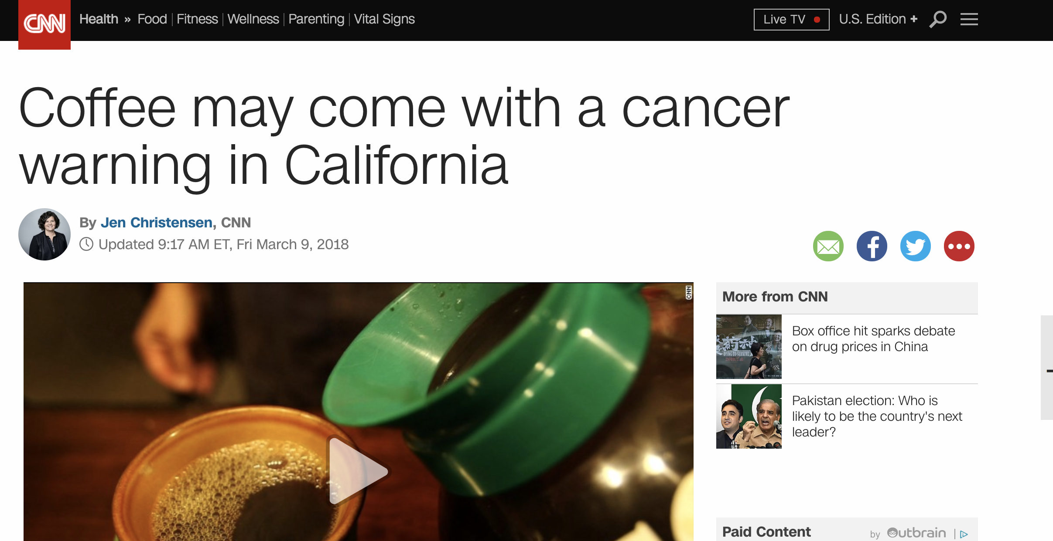
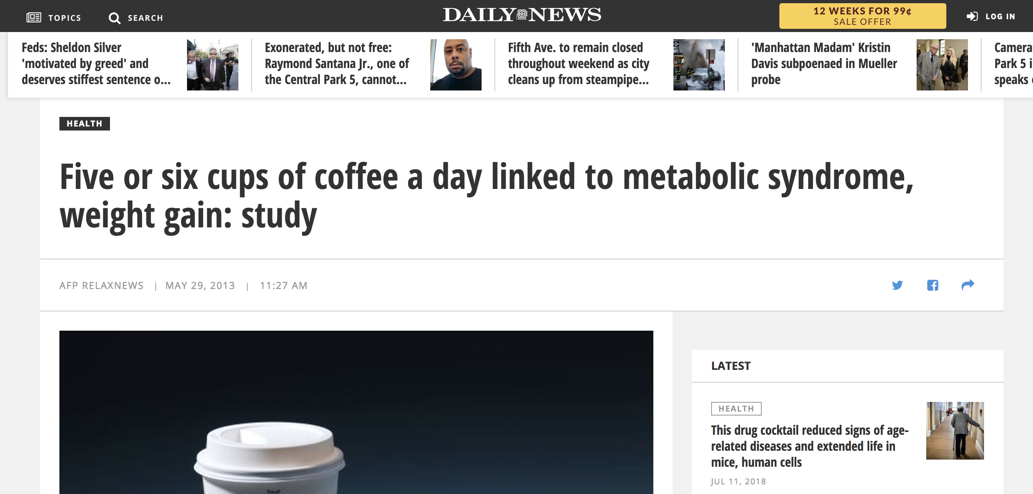
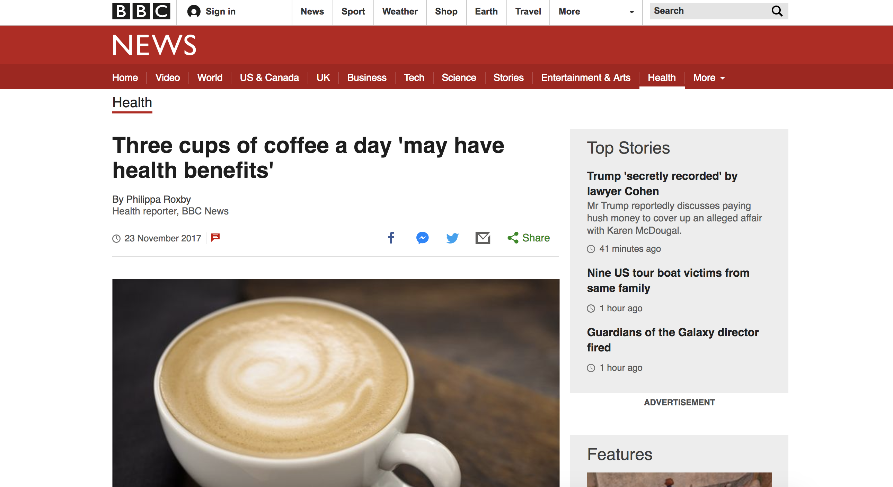
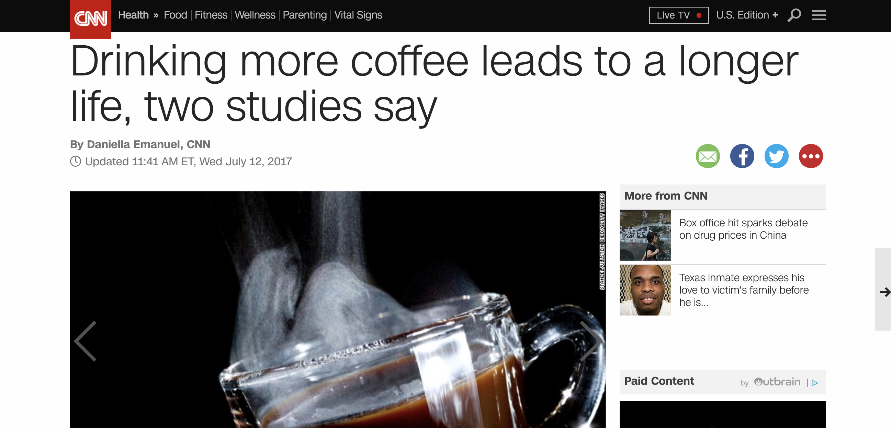
Correlations

Slide 26
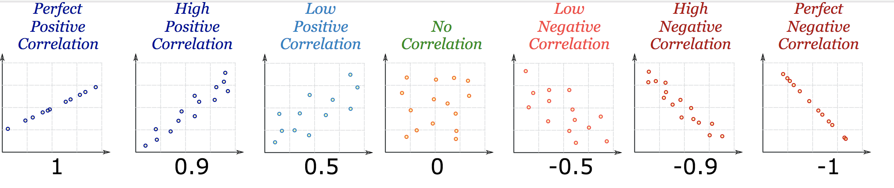
Correlations

Slide 27
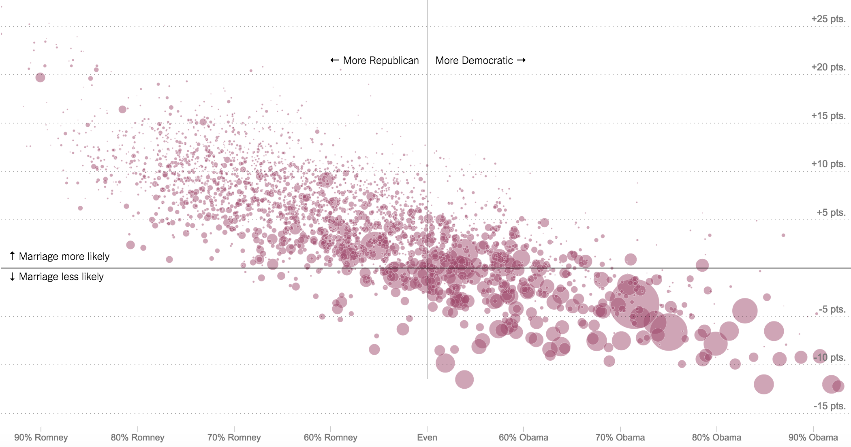
Correlations
What kind of correlation
b/w Democrats and marriage rates?

Slide 28
Correlations
Strong negative correlation

Slide 29
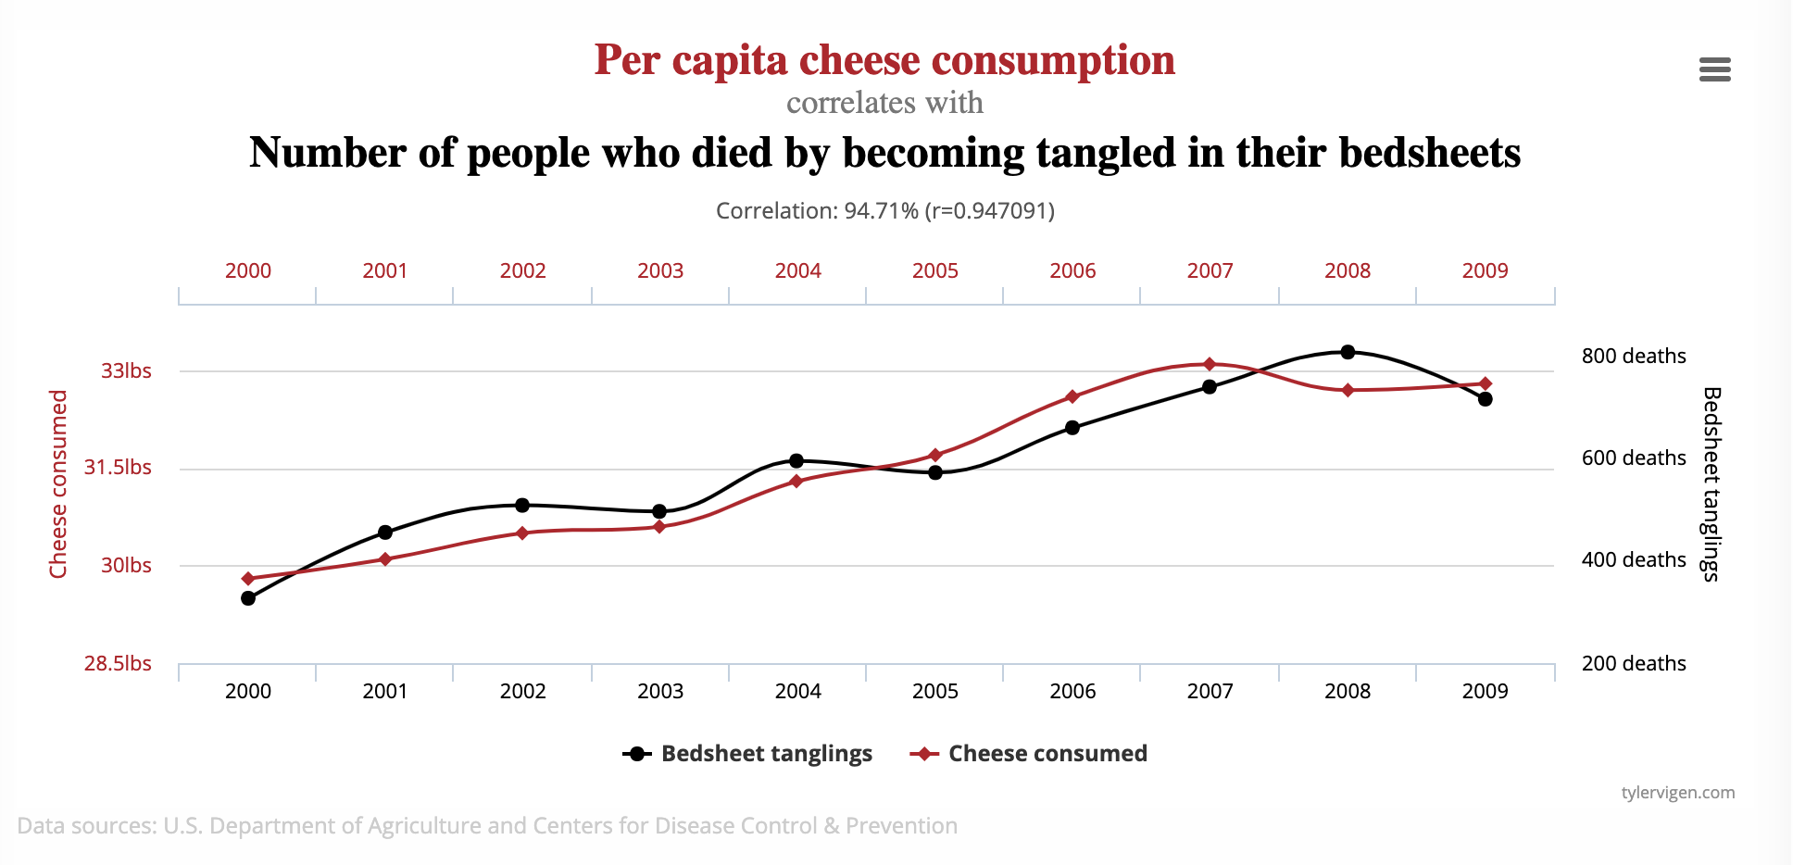
Correlations
Correlations

Slide 30
Correlations
Correlations

Slide 31
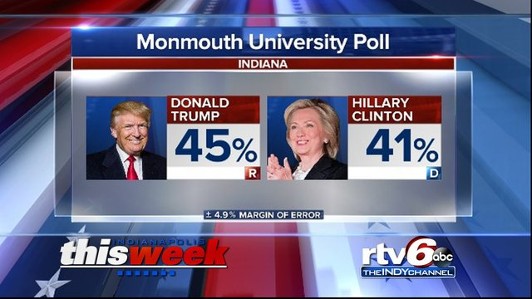
Margin of error
Standard is to have 95 percent threshold

Slide 32
Margin of error
What determines the margin of error
Bigger sample (number of people polled)
Lower/higher margin of error?
Higher certainty requirement (i.e. 95% vs 90%)
Lower/higher margin of error?

Slide 33
Margin of error
What determines the margin of error
Bigger sample (number of people polled)
Lower/higher margin of error?
Higher certainty requirement (i.e. 95% vs 90%)
Lower/higher margin of error?

Slide 34
Regression/inference
So how do we describe this?
45%
40.1%
49.9%
We are 95 percent confident the true percentage of all voters supporting Trump in Indiana is somewhere between 40.1 and 49.9

Slide 35
Random sample
Without a random sample, nothing else matters because bias!
Probably not random

Slide 36
Random sample
Talk with partner about how these non-random samples could introduce bias
To get monthly grocery spending habits, you survey everyone who stops at the Safeway fancy cheese station
To gauge DC residents’ position on green energy, you survey every third person who walks by the Washington Monument
To gauge America’s reaction to Trump’s press conference, Breitbart.com puts a poll on its home page

Slide 37
Random sample
Better (but not always practical):
To get monthly grocery spending habits, I use a computer to randomly generate list of 75 shoppers I’ll talk to as they leave the store ( 18th, 22nd, 38th, etc)
To gauge DC residents’ position on green energy, I randomly select 200 addresses from the phone book then go to interview the occupants
To gauge America’s reaction to Trump’s press conference, I use random-digit dialing to call 500 Americans

Slide 38
Writing about Stats
To make a very small number more understandable, divide it into 1. For example, .0081 is the proportion of the U.S. population who die every year. 1/.0081 translates to 1 in every 124 Americans die each year.
Limit yourself to no more than 12 digits, including dates such as 2012, in a single paragraph.
-Sarah Cohen, data editor NYT

Slide 39
Writing about Stats
Add context as a proportion of the whole: “At the time of the Million Man March in 1995, a turnout of 1 million black men would have represented 1/12th of all the black men in the country at the time.”
Put things in scale: https://www.youtube.com/watch?v=aKrFFFpYgkU

Slide 40
Percentages
(NOO! ☺)
Calculating percentage changes and HELP YOUR COLLEAGUES!
New - old
OR
change
old
old

Slide 41


Percentages
City budget increases fire dept funding by $500,000 and police funding by $500,000
Previous fire dept funding was $2.3 million
Previous police funding was $4.1 million
Which has bigger pct increase?
(new)
old
(new)
old
(2.3 + .5) – 2.3
2.3
(4.1 + .5) – 4.1
4.1
old
old

Slide 42
Percentages
City budget increases fire dept funding by $500,000 and police funding by $500,000
Previous fire dept funding was $2.3 million
Previous police funding was $4.1 million
Which has bigger pct increase?
+21.7%
12.2%

Slide 43
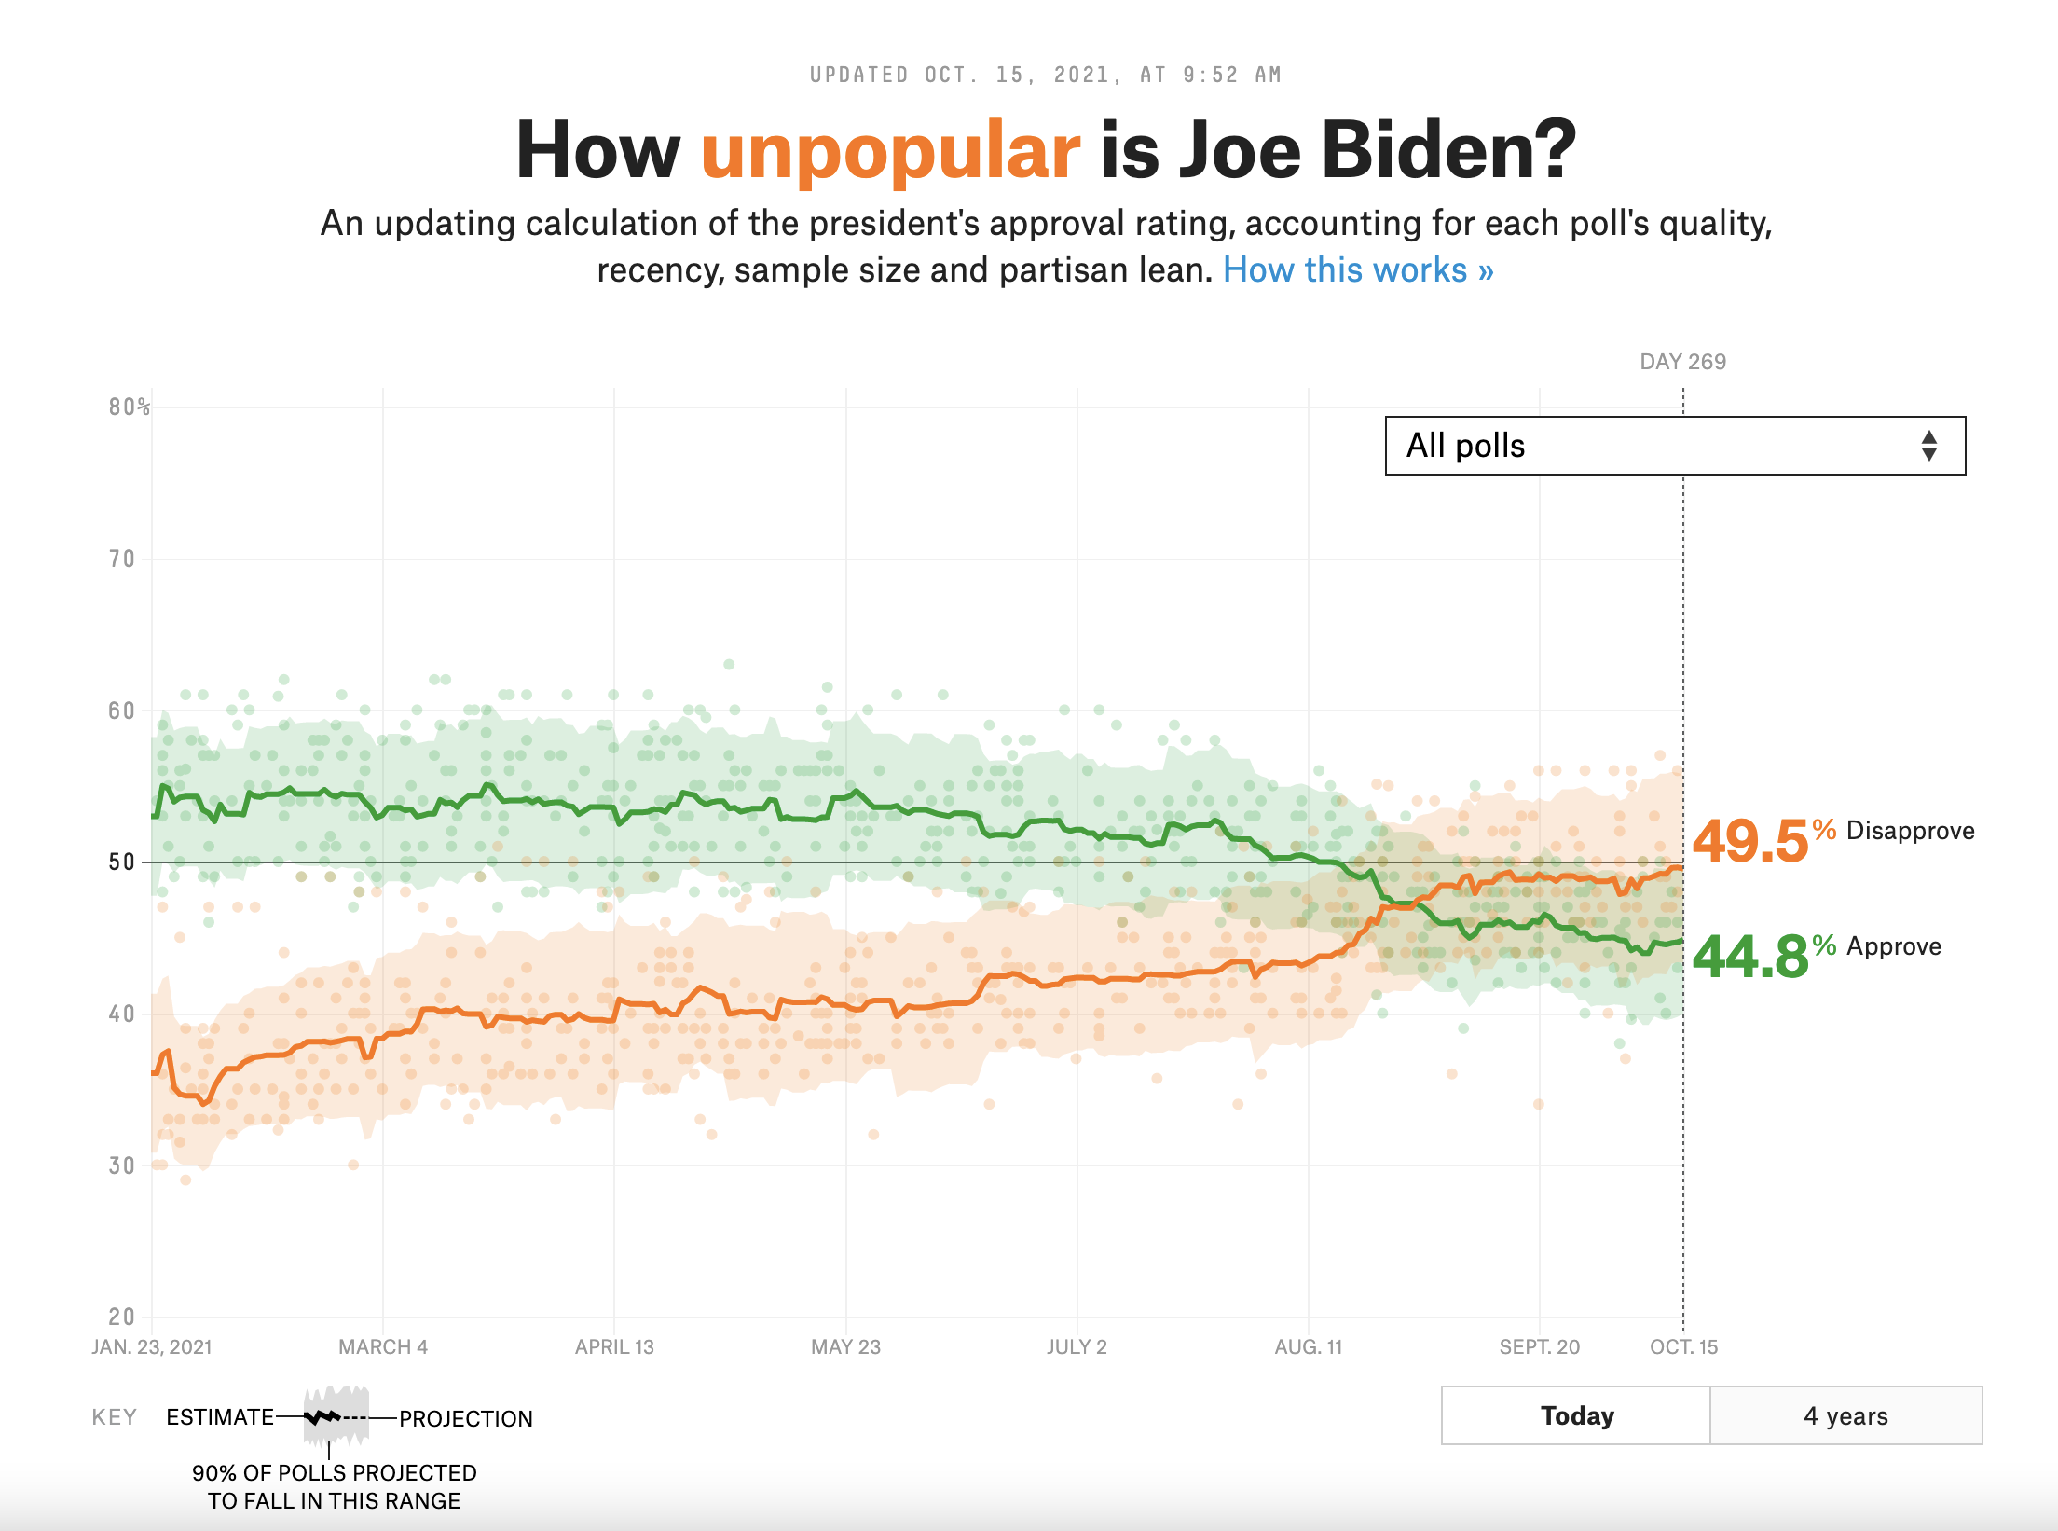
Percentages
Consider changes: percent vs. percent points
Biden approval rating 6 months ago: 52.8%
Biden approval rating this week: 44.8%
-? pct pts. change
+?% change

Slide 44
Percentages
Consider changes: percent vs. percent points
Biden approval rating 6 months ago: 52.8%
Biden approval rating this week: 44.8%
-8 pct pts. change
-15% change

